Slide 1
Credit card approval systeme
Presented by:
Hussein Fawaz

Slide 2
Table of contens
About Me
Internship Journey with Clevered
Domain of Project
Teacher’s Help
Any Question

Slide 3
About me
My name is HUSSEIN FAWAZ i’m 16 years old.
I live in Lebanon and i’m in 11th grade in school.
I’m currently in the clevered internship program, and my goal is to have a great experience in this domaine.

Slide 4
Internship journey with clevered
My internship journey with Clevered has been amazing so far. And every teacher that has teached me so far did a great job with keeping us updated if anything happend which has helped me stay all this time with Clevered.

Slide 5
Credit card approval system
The CREDIT CARD APPROVAL SYSTEM is a program that helps every user check every transaction that comes throught and out the bank. The reason that i chose this project was the finacial and banks problems that my country faced. So i wanted to know how all those things work. And also to test my capibilities of code and work.

Slide 6
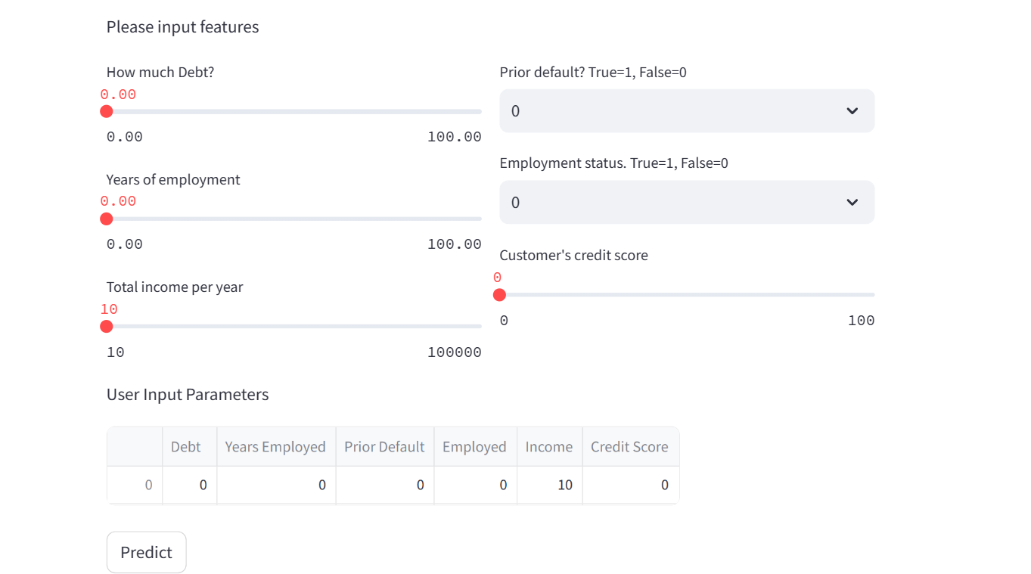
USER INTERFACE

Slide 7
HOW TO USE THE APP
S. No. Element Action What happens?
1 Element is slider. Drag it drags the debt amount between 0-100
2 Element is slider. Drag It drags the year of employment between 0-100.
3 Element is slider. Drag It drag the annual income between 0-100000
4 Element is dropdown select from menu IT selects eitheir a person is prior default or not
5 Element is dropdown select from menu It selects the employments status: yes or no
6 Element is slider. Drag it drags the credit score between 1-100
7 Element is button click It predicts wether the credit card is approved or not

Slide 8
Teachers help
Mrs SHIVANI and Mr ASHIVEK were very helpful during the preparation for the project and gave a lot of their time for my benefits and own good so my project would be completed without any problem.

Slide 9
Any question ?

